Slide 1
Module A
Unit A2
Vocabulary
Language Functions
Speaking Activities
UTN FRVM Lic. Evangelina Cecchel - Lic. Bibiana Fernandez

Slide 2
Unit A2
Comparative and superlative degree
UTN FRVM Lic. Evangelina Cecchel - Lic. Bibiana Fernandez

Slide 3
Comparative degree
UTN FRVM Lic. Evangelina Cecchel - Lic. Bibiana Fernandez

Slide 4
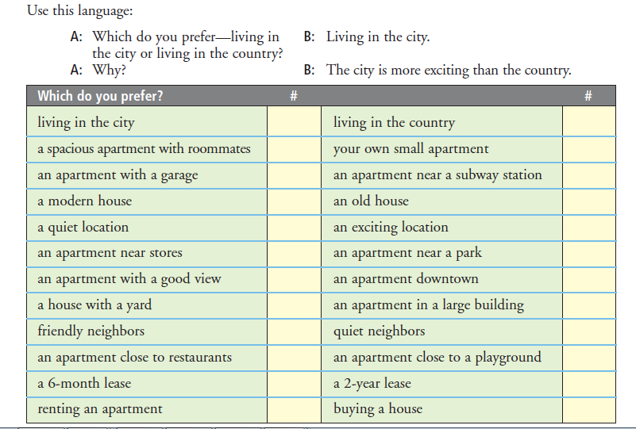
UTN FRVM Lic. Evangelina Cecchel - Lic. Bibiana Fernandez

Slide 5
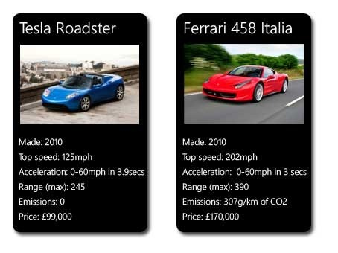
Compare the items in the images.
Vocabulary link: http://www.ompersonal.com.ar/omgrammar/adjetivoscalificativos.htm
UTN FRVM Lic. Evangelina Cecchel - Lic. Bibiana Fernandez

Slide 6
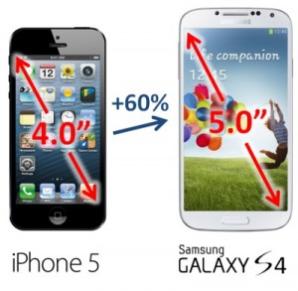
Compare the items in the images.
Vocabulary link: http://www.ompersonal.com.ar/omgrammar/adjetivoscalificativos.htm
UTN FRVM Lic. Evangelina Cecchel - Lic. Bibiana Fernandez

Slide 7
Superlative degree
UTN FRVM Lic. Evangelina Cecchel - Lic. Bibiana Fernandez

Slide 8
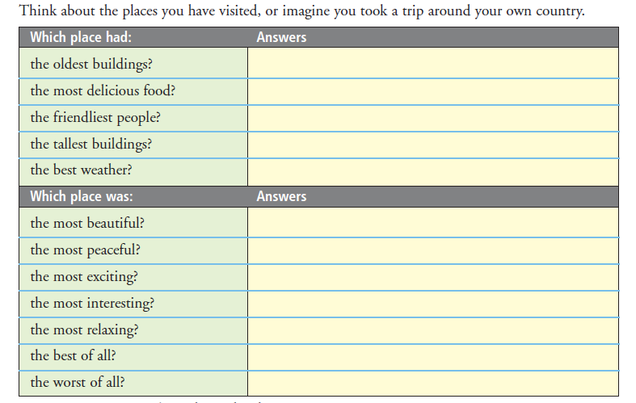
UTN FRVM Lic. Evangelina Cecchel - Lic. Bibiana Fernandez

Slide 9
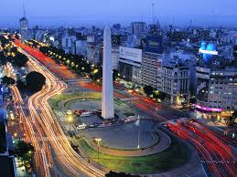
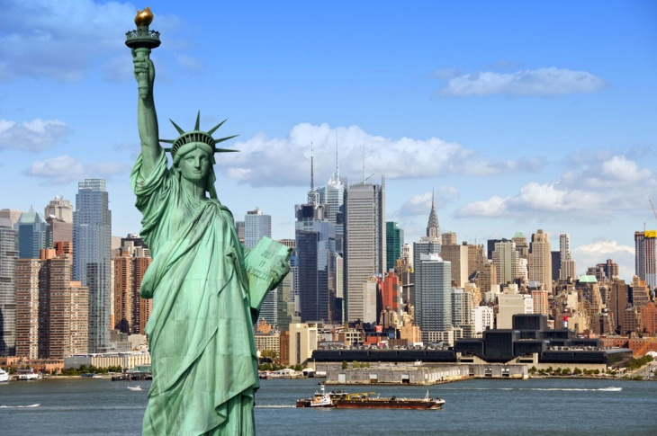
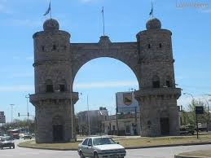
Compare all he items in the images.
Vocabulary link: http://www.ompersonal.com.ar/omgrammar/adjetivoscalificativos.htm
Your city or town
UTN FRVM Lic. Evangelina Cecchel - Lic. Bibiana Fernandez

